Slide 1
Clarity Begins at Home
Chen Chen Xiumin Martin Sugata Roychowdhury
Xin Wang
Matthew Billet
Presented by Austin Francis

Slide 2
Research Question
How does the level of internal information asymmetry (IIA), or differences in information access between top managers and divisional managers, influence a company's external communication quality?
Notes:
This paper explores how the difference in information between top managers and divisional managers (like department heads) affects a company's communication with the outside world. Think of it like this: if the folks at the top aren't getting all the information from those running the day-to-day operations, things can get messy.

Slide 3
Prior Literature
Previous research has examined the impact of internal information asymmetry (IIA) on capital allocation decisions within multi-division firms. Analytical models have highlighted the critical role of IIA in these decisions, emphasizing the potential for inefficiencies when information is unevenly distributed between corporate headquarters and division managers.
Empirical studies have provided evidence supporting the influence of IIA on investment efficiency. Researchers have found that disparities in information between divisional and corporate managers can significantly impact the effectiveness of capital allocation and investment decisions.
Some prior work has also explored the connection between internal information quality and external communication quality. For instance, some studies have focused on the effect of organizational complexity, measured by factors like the diversity of geographic and industry segments, on a firm's voluntary disclosure practices.

Slide 4
Hypothesis
The paper predicts that IIA negatively affects the accuracy, specificity, and frequency of management earnings forecasts.
The authors hypothesize that higher IIA leads to an increased likelihood of error-driven accounting restatements.
However, the relationship between high IIA and irregularity-driven restatements, stemming from intentional misreporting, remains ambiguous and is left as an open empirical question.

Slide 5
Data Collection
The study utilized data from various sources, including Compustat, the TFN Insider Filing Database, the First Call database, and the Audit Analytics database, to construct a comprehensive dataset spanning 1994 to 2011.
The final sample comprises 11,607 management earnings forecasts from 711 unique firms and 4,134 firm-year observations for accounting restatements, including 409 firm-years with restatements due to accounting errors.
Researchers meticulously hand-collected division-level data for a subset of S&P 1500 firms to validate the DIFRET measure.

Slide 6
DIFRET Explained
DIFRET is a novel measure of Internal Information Asymmetry (IIA) specifically designed to capture the difference in private information between divisional managers and top managers within a firm. This contrasts with other measures of information asymmetry that may focus on broader firm-level characteristics, but not on specific information disparities between different levels of management.
DIFRET is calculated using insider trading data, specifically by comparing the profitability of opportunistic trades made by divisional managers to those made by top managers. Opportunistic trades are identified as trades that deviate from routine trading patterns and are more likely to reflect the use of private information. The greater the difference in trading profitability (with divisional managers outperforming top managers), the higher the DIFRET value and the greater the presumed IIA.
Notes:
●
DIFRET is crucial to this paper because it allows the authors to examine the impact of this specific type of information asymmetry on the quality of external communication, a topic that had not been explored in prior research. By employing this measure, the authors are able to show that higher IIA (as indicated by a larger DIFRET) is associated with lower accuracy, specificity, and frequency of management forecasts, as well as an increased likelihood of error-driven accounting restatements. This highlights the important role that information flow within a firm plays in the quality of its external disclosures
To figure this out, the researchers came up with a new metric called DIFRET. This basically measures who's making better decisions based on the information they have. They do this by looking at insider trading, which is when people who work for a company buy or sell its stock. Now, not all insider trading is shady. Sometimes it's just routine. But sometimes, it's based on information that isn't public yet – that's called "opportunistic" trading. If divisional managers are consistently making more money from their opportunistic trades than the top managers, it means they have better information. That leads to a higher DIFRET score, indicating more information asymmetry.

Slide 7
Results
The study found a statistically significant negative correlation between DIFRET, the measure of IIA, and the accuracy, bias, specificity, and frequency of management earnings forecasts.
Higher DIFRET scores were significantly associated with an increased probability of error-driven restatements but did not correlate with irregularity-driven restatements.
The results remained robust even after addressing potential endogeneity issues using instrumental variables and accounting for First Call data coverage concerns.
Notes:
The authors found that when DIFRET is high, companies tend to communicate less clearly with investors and the public. Their earnings forecasts, which are predictions of how much profit they'll make, become less accurate, less specific, and less frequent. They also tend to be more pessimistic, perhaps because the top managers lack confidence in their own information.
But it's not just about voluntary communication. Even legally required financial statements can become less reliable when there's a lot of information asymmetry. The researchers found that companies with high DIFRET scores were more likely to have to restate their earnings – meaning they had to correct mistakes in their original reports. This suggests that when the top managers aren't fully in the loop, it's harder to make sure the financial statements are accurate.

Slide 8
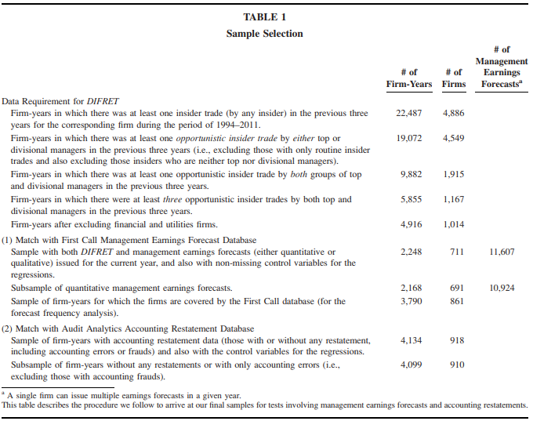
Notes:
Here is the information you requested for Table 1 from your source:
1. High Level Summary of Table 1
Table 1 outlines the sample selection process used by the authors of "Clarity Begins at Home" in their study on the relationship between internal information asymmetry (IIA) and external communication quality. It details the number of firm-years and unique firms included at each stage, starting with a large sample of earnings forecasts and progressively narrowing it down to the final samples used for analyzing management earnings forecasts and accounting restatements.
2. Reason for Inclusion of Table 1
The authors included Table 1 to provide transparency and allow readers to understand how the final sample was derived. It showcases the steps taken to select the relevant observations, ensuring the rigor and reliability of the research findings.
3. Independent and Dependent Variables in Table 1
Table 1 itself doesn't explicitly list independent or dependent variables used in the study. It focuses solely on describing the sample construction process. The independent and dependent variables used in the various analyses are defined in Appendix A of the paper.
4. Key Numbers to Focus On
The key numbers in Table 1 are the final sample sizes for the two main analyses:
●
Management Earnings Forecasts: 3,790 firm-year observations and 861 unique firms. This is the sample used to analyze the association between IIA and characteristics of management earnings forecasts.
●
Accounting Restatements: 4,134 firm-year observations and 918 unique firms. This sample is further divided into subsamples based on the type of restatement: accounting errors (409 firm-years) and accounting irregularities (35 firm-years).
5. Script to Explain Table 1
"Table 1 illustrates how the authors carefully selected the companies used in their study. Starting with over 2,000 companies issuing earnings forecasts, they applied several filters to ensure they were focusing on multi-segment firms with sufficient data on both insider trading and accounting restatements. Through this rigorous process, they arrived at two final sets of companies – one for examining the quality of earnings forecasts and another to analyze the likelihood of accounting restatements. By being transparent about their sample selection process, the authors enhance the credibility and reliability of their research findings."

Slide 9
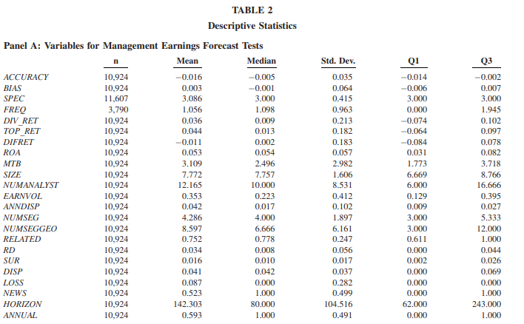
Notes:
Here's the analysis of Table 2 from the provided research paper:
1. High Level Summary of Table 2
Table 2 presents descriptive statistics for the variables used in the study. It is divided into three panels:
●
Panel A: Focuses on variables related to management earnings forecasts, including forecast accuracy (ACCURACY), bias (BIAS), specificity (SPEC), frequency (FREQ), and the key independent variable, DIFRET, which measures internal information asymmetry.
●
Panel B: Provides descriptive statistics for variables used in examining accounting errors (RES_ERR), including the likelihood of restatements driven by accounting errors.
●
Panel C: Offers a comparative analysis of firm characteristics across four different samples: all multi-segment firms, multi-segment firms with insider trades, firms with positive DIFRET, and firms with negative DIFRET.
2. Reason for Inclusion of Table 2
The authors include Table 2 to provide a preliminary understanding of the data used in their study. It allows readers to assess the distributional characteristics of key variables, compare the features of different subsamples, and gain initial insights into potential relationships between variables before proceeding to the formal hypothesis testing.
3. Independent and Dependent Variables
●
Independent Variable: The primary independent variable across analyses is DIFRET, which measures internal information asymmetry.
●
Dependent Variables: The dependent variables vary depending on the specific analysis:
○
Management Earnings Forecast Analyses: ACCURACY, BIAS, SPEC, and FREQ.
○
Accounting Restatement Analyses: RES_ERR (error-driven restatements) and RES_IRR (irregularity-driven restatements).
4. Key Numbers to Pay Attention To
●
Panel A: The mean value of DIFRET is -0.011, indicating that, on average, top managers trade more profitably than divisional managers. This suggests a generally lower level of internal information asymmetry in the sample.
●
Panel B: The mean value of RES_ERR is 0.100, meaning that 10% of the sample firm-years experienced restatements due to accounting errors.
●
Panel C: Focus on the differences in firm characteristics (ROA, MTB, SIZE, etc.) between the "Universal Multi-Segment Firm-Years" sample and the final samples used for the analyses (DIFRET > 0 and DIFRET < 0). This helps understand how the sample changes with the inclusion of insider trading data and the calculation of DIFRET.
5. Script to Explain Table 2
"Table 2 gives us a snapshot of the data used in the study. It tells us things like the average profitability of insider trades and the percentage of companies that had to restate their earnings. What's interesting is that, on average, top managers seem to be more informed than divisional managers based on their trading profits. The table also shows how the characteristics of the companies in the study change as the researchers focus on those with data on insider trading. This table helps us understand the data before the researchers dive into testing their hypotheses."

Slide 10
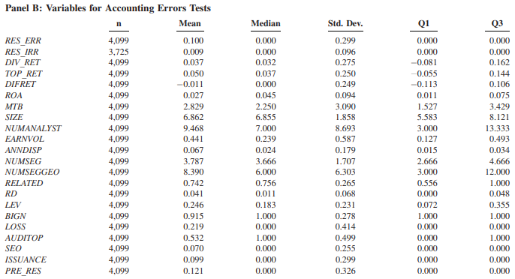
Notes:
●
Panel B: Provides descriptive statistics for variables used in examining accounting errors (RES_ERR), including the likelihood of restatements driven by accounting errors.
●
Panel B: The mean value of RES_ERR is 0.100, meaning that 10% of the sample firm-years experienced restatements due to accounting errors.

Slide 11
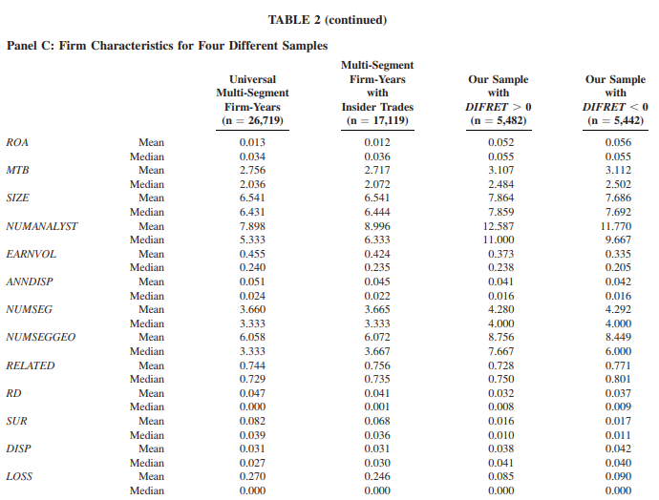
Notes:
●
Panel C: Focus on the differences in firm characteristics (ROA, MTB, SIZE, etc.) between the "Universal Multi-Segment Firm-Years" sample and the final samples used for the analyses (DIFRET > 0 and DIFRET < 0). This helps understand how the sample changes with the inclusion of insider trading data and the calculation of DIFRET.
●
Panel C: Focus on the differences in firm characteristics (ROA, MTB, SIZE, etc.) between the "Universal Multi-Segment Firm-Years" sample and the final samples used for the analyses (DIFRET > 0 and DIFRET < 0). This helps understand how the sample changes with the inclusion of insider trading data and the calculation of DIFRET.

Slide 12
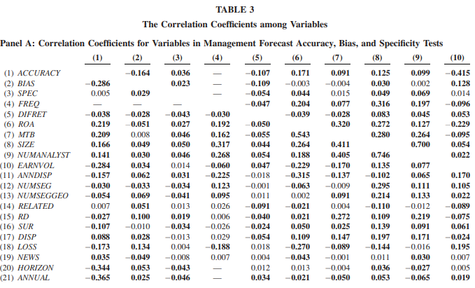
Notes:
Here's an analysis of Table 3 from the research paper, addressing your specific questions:
1. High-Level Summary of Table 3
Table 3 presents the correlation coefficients between the various variables used in the study. It's divided into four panels:
●
Panels A & B: Display correlations for the sample examining management earnings forecasts.
●
Panels C & D: Show correlations for the sample used in the accounting restatements tests.
The table uses both Pearson (measuring linear correlation) and Spearman (measuring rank correlation) coefficients to provide a comprehensive understanding of the relationships between variables.
2. Reason for Inclusion of Table 3
The authors include Table 3 to offer an initial assessment of the relationships between variables. This helps in identifying potential associations that can be formally tested in subsequent analyses. It also allows readers to assess the strength and direction of these relationships, providing valuable context for interpreting the main findings of the study.
4. Key Numbers to Pay Attention To
The most important correlations to note in Table 3 are those involving DIFRET, the measure of internal information asymmetry:
●
Panels A & B: DIFRET is negatively correlated with ACCURACY, BIAS, SPEC, and FREQ. This initial observation supports the authors' hypothesis that higher internal information asymmetry is associated with poorer quality management forecasts.
●
Panels C & D: DIFRET is positively correlated with RES_ERR, suggesting that higher internal information asymmetry is linked to an increased likelihood of error-driven restatements. Notably, DIFRET is not significantly correlated with RES_IRR (irregularity-driven restatements).
5. Script to Explain Table 3
"Table 3 gives us a glimpse into how the different factors in the study relate to each other. What we see is that the measure of internal information asymmetry, called DIFRET, has some interesting relationships. For example, when DIFRET is higher, the accuracy, bias, and specificity of management earnings forecasts tend to be worse. This is shown by the negative correlations in the table.“
"We also see that a higher DIFRET is associated with an increased chance of a company having to restate its earnings due to errors – this is reflected in the positive correlation with RES_ERR. However, there doesn't seem to be a clear link between DIFRET and restatements caused by intentional misreporting (irregularities). These initial findings from the correlations in Table 3 set the stage for more detailed analyses later in the study."

Slide 13
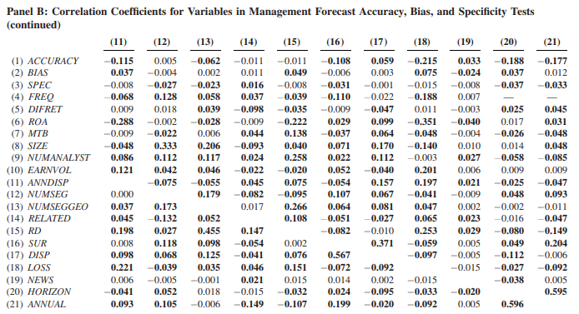
Notes:
●
Panels A & B: DIFRET is negatively correlated with ACCURACY, BIAS, SPEC, and FREQ. This initial observation supports the authors' hypothesis that higher internal information asymmetry is associated with poorer quality management forecasts.

Slide 14
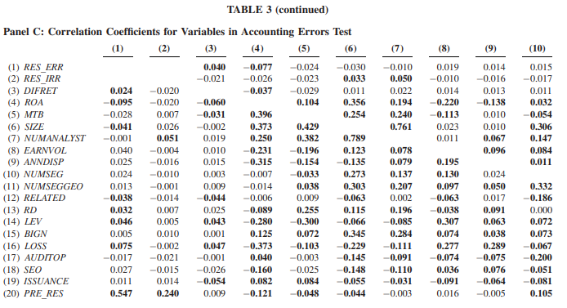
Notes:
Panels C & D: Show correlations for the sample used in the accounting restatements tests.
The table uses both Pearson (measuring linear correlation) and Spearman (measuring rank correlation) coefficients to provide a comprehensive understanding of the relationships between variables.
●
Panels C & D: DIFRET is positively correlated with RES_ERR, suggesting that higher internal information asymmetry is linked to an increased likelihood of error-driven restatements. Notably, DIFRET is not significantly correlated with RES_IRR (irregularity-driven restatements).

Slide 15
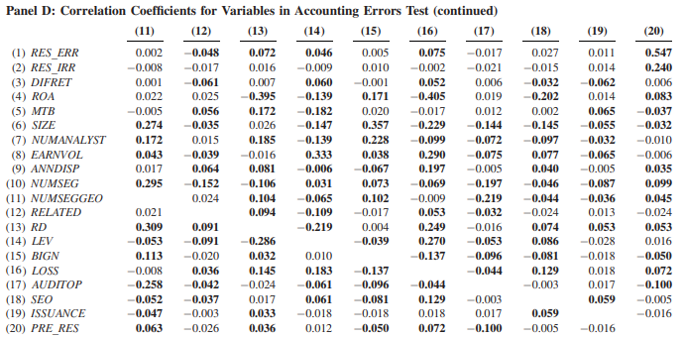

Slide 16
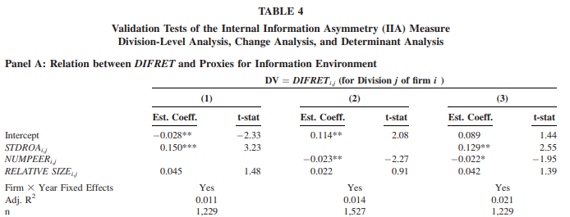
Notes:
Here is an analysis of Table 4 from the research paper, addressing your specific questions:
1. High-Level Summary of Table 4
Table 4 explores the determinants and validation of the IIA measure (DIFRET) across different levels of analysis. It's divided into four panels:
●
Panel A: Examines the relationship between DIFRET at the division level and two proxies for the information environment: divisional return on assets (ROA) volatility (STDROA) and the number of comparable publicly listed peers (NUMPEER).
●
Panel B: Investigates changes in division-level DIFRET surrounding changes in flight time between corporate headquarters and division locations (FLIGHT_TIME) and shifts in the GARMAISE index, which measures the enforceability of non-competition agreements.
●
Panel C: Analyzes DIFRET in the context of CEO turnover, comparing changes in DIFRET when the incoming CEO is an outsider versus an insider.
●
Panel D: Conducts a firm-level analysis to identify economic determinants of DIFRET, considering factors such as firm size, market-to-book ratio, and the number of segments.
2. Reason for Inclusion of Table 4
The authors include Table 4 to demonstrate that DIFRET, their measure of internal information asymmetry, behaves as expected based on economic theory and empirical predictions. By showing that DIFRET varies predictably with factors likely to influence information asymmetry, the authors enhance the validity of their measure.
3. Independent and Dependent Variables
●
Dependent Variable: The dependent variable in all panels of Table 4 is DIFRET, the measure of internal information asymmetry.
●
Independent Variables: The independent variables vary across the panels:
○
Panel A: STDROA, NUMPEER, and RELATIVE SIZE (the division's assets as a percentage of total firm assets).
○
Panel B: Changes in FLIGHT_TIME and GARMAISE before and after specific events.
○
Panel C: Nature of CEO turnover (outsider vs. insider).
○
Panel D: FLIGHT_TIME, GARMAISE, and various firm characteristics.
4. Key Numbers to Pay Attention To
●
Panel A:
○
The positive coefficient on STDROA (Columns 1 & 3) supports the idea that greater operating volatility at the division level leads to higher information asymmetry.
○
The negative coefficient on NUMPEER (Columns 2 & 3) suggests that having more comparable public firms in the same industry reduces information asymmetry, likely because more public information is available.
●
Panel B:
○
The significant decline in DIFRET following a decrease in flight time (-0.09, a 40% change relative to the standard deviation) suggests that improved connectivity between headquarters and divisions can reduce information asymmetry.
○
Conversely, an increase in flight time is associated with a significant increase in DIFRET (+0.072, a 28% change relative to the standard deviation).
●
Panel C:
○
The increase in DIFRET when an outsider CEO takes over (+0.077, a 35% change relative to the standard deviation) supports the notion that outsider CEOs initially face higher information asymmetry than insider CEOs.
●
Panel D:
○
The positive coefficients on FLIGHT_TIME and GARMAISE at the firm level reinforce the findings from Panel B.
○
The negative coefficient on MTB suggests that firms with higher growth opportunities might have less information asymmetry, possibly because top managers in such firms have a greater incentive to stay informed.
5. Script to Explain Table 4
"Table 4 provides a deeper look into our measure of internal information asymmetry, DIFRET. We wanted to make sure that this measure actually captures differences in information between top managers and those running different parts of the company. The table shows that DIFRET behaves in ways that make sense based on what we know about information."
"For example, when a division's performance is more volatile, there's more information asymmetry - shown by the positive relationship with STDROA. Also, when it's harder for top managers to travel to a division because of longer flight times, we see DIFRET go up - this makes sense because it's harder to get information when you can't easily meet face-to-face. The table also shows that when a new CEO comes from outside the company, information asymmetry increases. These findings give us confidence that DIFRET is a good way to measure those information gaps within companies."

Slide 17
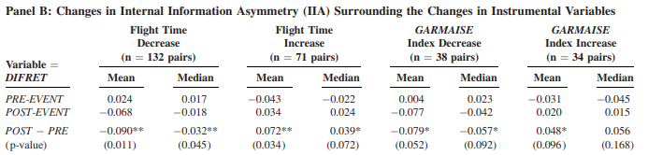
Notes:
●
Panel B: Investigates changes in division-level DIFRET surrounding changes in flight time between corporate headquarters and division locations (FLIGHT_TIME) and shifts in the GARMAISE index, which measures the enforceability of non-competition agreements.
Independent variables ○
Panel B: Changes in FLIGHT_TIME and GARMAISE before and after specific events.
●
Panel B:
○
The significant decline in DIFRET following a decrease in flight time (-0.09, a 40% change relative to the standard deviation) suggests that improved connectivity between headquarters and divisions can reduce information asymmetry.
○
Conversely, an increase in flight time is associated with a significant increase in DIFRET (+0.072, a 28% change relative to the standard deviation).

Slide 18
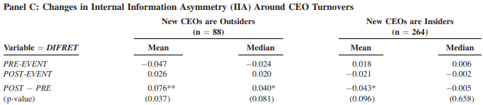
Notes:
●
Panel C: Analyzes DIFRET in the context of CEO turnover, comparing changes in DIFRET when the incoming CEO is an outsider versus an insider.
○
Panel C: Nature of CEO turnover (outsider vs. insider).
Panel C:
○
The increase in DIFRET when an outsider CEO takes over (+0.077, a 35% change relative to the standard deviation) supports the notion that outsider CEOs initially face higher information asymmetry than insider CEOs.

Slide 19
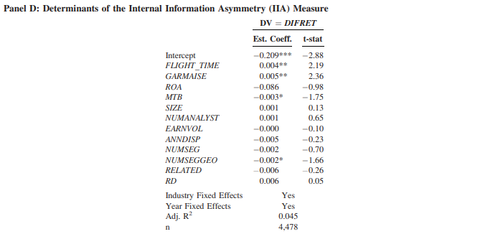
Notes:
●
Panel D: Conducts a firm-level analysis to identify economic determinants of DIFRET, considering factors such as firm size, market-to-book ratio, and the number of segments.
○
Panel D: FLIGHT_TIME, GARMAISE, and various firm characteristics.
●
Panel D:
○
The positive coefficients on FLIGHT_TIME and GARMAISE at the firm level reinforce the findings from Panel B.
○
The negative coefficient on MTB suggests that firms with higher growth opportunities might have less information asymmetry, possibly because top managers in such firms have a greater incentive to stay informed.

Slide 20
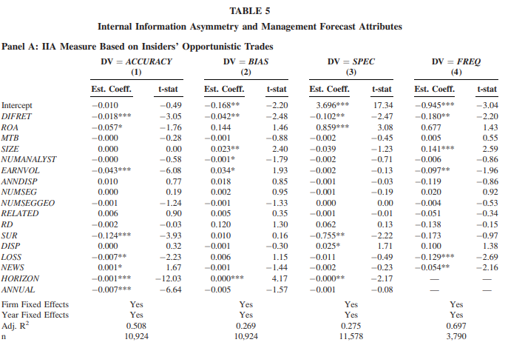
Notes:
1. High-Level Summary of Table 5
Table 5 examines the connection between internal information asymmetry (IIA), as measured by DIFRET, and various attributes of management earnings forecasts. It's divided into two panels:
●
Panel A: Presents the results when DIFRET is calculated using insiders' opportunistic trades (those likely to be based on private information).
●
Panel B: Provides a placebo test using DIFRET_ROUTINE, calculated using insiders' routine trades (those less likely to reflect private information).
Each panel contains four columns, each with a different dependent variable related to management forecasts:
●
Column 1: ACCURACY - Measures how close the forecasts are to actual earnings.
●
Column 2: BIAS - Assesses if forecasts tend to be overly optimistic or pessimistic.
●
Column 3: SPEC - Evaluates the level of detail and specificity in the forecasts.
●
Column 4: FREQ - Represents how often companies issue earnings forecasts.
2. Reason for Inclusion of Table 5
This table is included to test a central hypothesis of the research: that higher internal information asymmetry leads to lower-quality management earnings forecasts. This is a crucial link in the study's argument that information problems within a firm can impact its external communication with investors.
3. Independent and Dependent Variables
●
Dependent Variables: The dependent variables are the four attributes of management forecasts listed above (ACCURACY, BIAS, SPEC, and FREQ).
●
Independent Variable: The primary independent variable of interest is DIFRET, the measure of internal information asymmetry. Several control variables are also included, such as firm size, profitability, and earnings volatility.
4. Key Numbers to Pay Attention To
●
Panel A: Focus on the coefficients for DIFRET in all four columns. All of these coefficients are negative and statistically significant.
○
Column 1: A one-unit increase in DIFRET is associated with a decrease of 0.018 in forecast accuracy1.
○
Column 2: A higher DIFRET is linked to more negatively biased forecasts, meaning forecasts tend to be lower than actual earnings1.
○
Columns 3 & 4: Higher DIFRET is associated with less specific forecasts and a lower frequency of forecast issuance1.
●
Panel B: The key takeaway here is that none of the coefficients for DIFRET_ROUTINE are statistically significant. This strengthens the argument that the results in Panel A are driven by information asymmetry, as captured by opportunistic trades.
5. Script to Explain Table 5
"Table 5 examines the impact of information differences within a company on the quality of their earnings forecasts. What we see is quite striking: when information asymmetry is high, the earnings forecasts provided by management tend to be less accurate, more pessimistic, less detailed, and less frequent."
"For instance, a higher DIFRET score, which means more information asymmetry, is linked to a 0.018 decrease in forecast accuracy. To put this into perspective, this effect is about one-fifth of the impact that earnings volatility has on accuracy2, which is considered a substantial factor. Importantly, when we repeat the analysis using a measure that doesn't capture private information (DIFRET_ROUTINE), we don't see these effects. This suggests that the information gaps we're measuring are the real drivers of these findings."

Slide 21
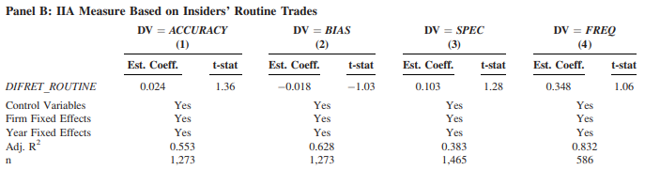
Notes:
●
Panel B: Provides a placebo test using DIFRET_ROUTINE, calculated using insiders' routine trades (those less likely to reflect private information).
●
Panel B: The key takeaway here is that none of the coefficients for DIFRET_ROUTINE are statistically significant. This strengthens the argument that the results in Panel A are driven by information asymmetry, as captured by opportunistic trades.

Slide 22
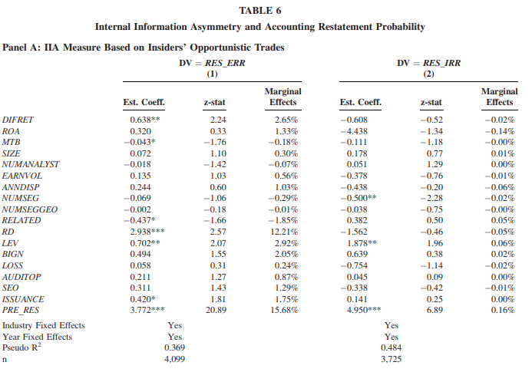
Notes:
1. High-Level Summary of Table 6
Table 6 investigates the relationship between internal information asymmetry (IIA), measured by DIFRET, and the probability of a company having to restate its earnings. It has two panels:
●
Panel A: Examines this relationship when DIFRET is based on insiders' opportunistic trades, which are more likely to be driven by private information.
●
Panel B: Performs a placebo test using DIFRET_ROUTINE, which is calculated based on insiders' routine trades that are less likely to be informed.
The table further divides the analysis into two columns:
●
Column 1: Focuses on restatements caused by accounting errors.
●
Column 2: Examines restatements due to irregularities, often associated with intentional misstatements or fraud.
2. Reason for Inclusion of Table 6
Table 6 is included to explore whether internal information problems, as reflected in high IIA, are linked to a higher likelihood of earnings restatements. This analysis complements the findings from Table 5 on management forecasts, further building the case that IIA can negatively affect a company's external financial reporting quality.
3. Independent and Dependent Variables
●
Dependent Variables: The dependent variables are the likelihood of earnings restatements due to errors (RES_ERR in Column 1) and irregularities (RES_IRR in Column 2).
●
Independent Variable: The main independent variable of interest is DIFRET. The table also includes several control variables known to be associated with restatement risk, such as firm size, profitability, leverage, and the presence of a Big N auditor.
4. Key Numbers to Pay Attention To
●
Panel A, Column 1: The coefficient on DIFRET is positive and statistically significant (0.638), suggesting that higher IIA is associated with an increased probability of error-driven restatements. The marginal effect of DIFRET on restatement probability is 2.65 percentage points, which is noteworthy considering that 10% of the sample experienced error-driven restatements.
●
Panel A, Column 2: The coefficient on DIFRET is negative but not statistically significant, implying that IIA, as measured here, is not strongly related to the likelihood of restatements due to irregularities. The sources note, however, that this analysis might lack statistical power due to limitations in the dataset regarding the identification of financial fraud.1
●
Panel B: The crucial observation is that the coefficient on DIFRET_ROUTINE is not statistically significant in either column. This reinforces the argument that the positive relationship observed in Panel A, Column 1, is driven by information asymmetry stemming from opportunistic, informed trades.
5. Script to Explain Table 6
"Table 6 shifts our focus from earnings forecasts to the accuracy of the financial statements themselves. We wanted to see if those internal information gaps we've been talking about also lead to more errors in companies' financial reports. And the findings in Table 6 suggest they do."
"We found a strong link between higher internal information asymmetry and a greater chance of companies having to restate their earnings due to errors. To be precise, for every one-unit increase in our DIFRET measure, the probability of an error-driven restatement goes up by 2.65 percentage points -- and this is after controlling for many other factors that could influence restatement risk. Interestingly, we don't see a similar effect for restatements caused by fraud, which suggests that information asymmetry is more likely to lead to unintentional mistakes rather than deliberate manipulation. Of course, this doesn't rule out the possibility that information problems contribute to fraud in some cases."

Slide 23
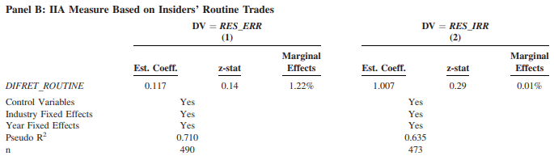
Notes:
●
Panel B: Performs a placebo test using DIFRET_ROUTINE, which is calculated based on insiders' routine trades that are less likely to be informed.
●
Panel B: The crucial observation is that the coefficient on DIFRET_ROUTINE is not statistically significant in either column. This reinforces the argument that the positive relationship observed in Panel A, Column 1, is driven by information asymmetry stemming from opportunistic, informed trades.

Slide 24
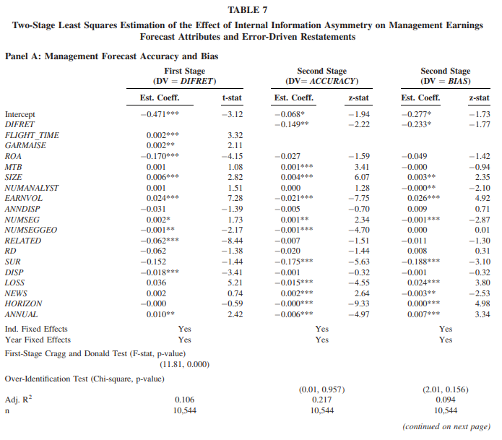
Notes:
1. High-Level Summary of Table 7
Table 7 uses a two-stage least squares (2SLS) estimation method to further examine the relationship between internal information asymmetry (IIA) and the quality of external communication in conglomerate firms. The table is divided into three panels:
●
Panel A: Focuses on management forecast accuracy (ACCURACY) and bias (BIAS).
●
Panel B: Examines management forecast specificity (SPEC) and frequency (FREQ).
●
Panel C: Investigates the likelihood of error-driven accounting restatements (RES_ERR).
Each panel presents both the first-stage results, where DIFRET (the measure of IIA) is the dependent variable, and the second-stage results, where the respective external communication quality measure is the dependent variable.
2. Reason for Inclusion of Table 7
The authors include Table 7 to address potential endogeneity concerns regarding the relationship between IIA and external communication quality. This is important because there could be a reverse causal relationship: companies with poor disclosure practices might be less likely to invest in gathering information from divisional managers, leading to higher IIA. The 2SLS approach, using instrumental variables, helps mitigate this concern and provides a more robust test of the hypothesized relationship.
3. Independent and Dependent Variables
●
Dependent Variable (First Stage): DIFRET in all panels.
●
Dependent Variables (Second Stage):
○
Panel A: ACCURACY and BIAS.
○
Panel B: SPEC and FREQ.
○
Panel C: RES_ERR.
●
Independent Variable: The primary independent variable is DIFRET (in the second stage).
●
Instrumental Variables: Two instrumental variables are used to predict DIFRET in the first stage:
○
FLIGHT_TIME: Average flight time between corporate headquarters and the locations of division managers.
○
GARMAISE: Average Garmaise index, which measures the enforceability of non-compete contracts in the states where division managers are located.
●
Control Variables: The second-stage regressions include several control variables similar to those used in Tables 5 and 6 to account for other factors that could influence external communication quality. These include firm size, profitability, leverage, and earnings volatility.
4. Key Numbers to Pay Attention To
●
First-Stage Results: In all panels, both FLIGHT_TIME and GARMAISE have positive and statistically significant coefficients in predicting DIFRET. This is consistent with the validation tests presented earlier in the paper and strengthens the case for using these variables as instruments.
●
Second-Stage Results:
○
Panel A: The coefficient on DIFRET is negative and statistically significant in the ACCURACY regression (-0.149), indicating that higher IIA is associated with less accurate management earnings forecasts. The coefficient on DIFRET is also negative and statistically significant in the BIAS regression (-0.233), suggesting that forecasts tend to be more pessimistic when IIA is high.
○
Panel B: The DIFRET coefficient is negative and statistically significant in both the SPEC (-1.550) and FREQ (-2.452) regressions, implying that higher IIA is linked to less specific and less frequent management forecasts.
○
Panel C: The DIFRET coefficient is positive and statistically significant (1.130) in the RES_ERR regression, supporting the finding that higher IIA increases the probability of error-driven accounting restatements.
5. Script to Explain Table 7
"In simpler terms, we had to rule out the possibility that companies with poor disclosure practices might be less motivated to bridge information gaps within the firm."
"To do this, we used a statistical technique called two-stage least squares estimation, which employs what are known as instrumental variables. We identified two factors - the flight time between corporate headquarters and divisional locations, and the strength of non-compete agreements in those locations - that are likely to affect information asymmetry but are unlikely to directly influence disclosure quality. The results from this analysis, shown in Table 7, reinforce our earlier findings. Even after addressing endogeneity concerns, we still see a consistent pattern: higher internal information asymmetry is associated with less accurate and less informative management forecasts, and a greater chance of companies needing to correct errors in their financial statements."

Slide 25
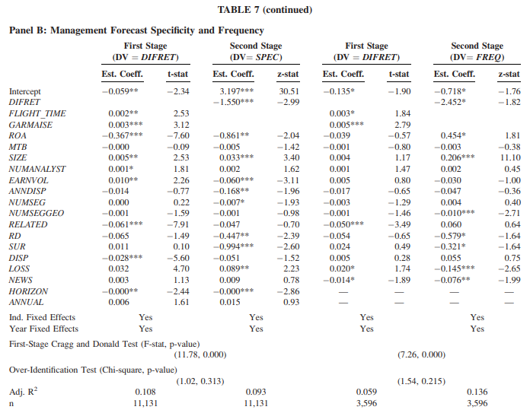
Notes:
●
Panel B: Examines management forecast specificity (SPEC) and frequency (FREQ).
○
Panel B: The DIFRET coefficient is negative and statistically significant in both the SPEC (-1.550) and FREQ (-2.452) regressions, implying that higher IIA is linked to less specific and less frequent management forecasts.

Slide 26
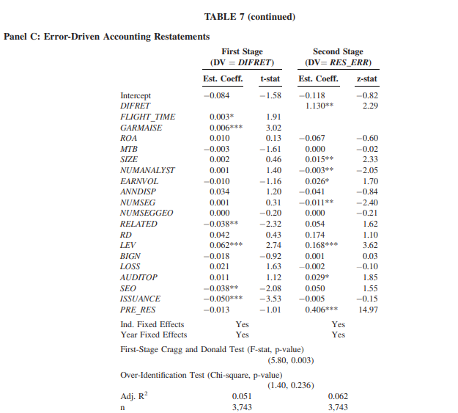
Notes:
●
Panel C: Investigates the likelihood of error-driven accounting restatements (RES_ERR).
○
Panel C: The DIFRET coefficient is positive and statistically significant (1.130) in the RES_ERR regression, supporting the finding that higher IIA increases the probability of error-driven accounting restatements.

Slide 27
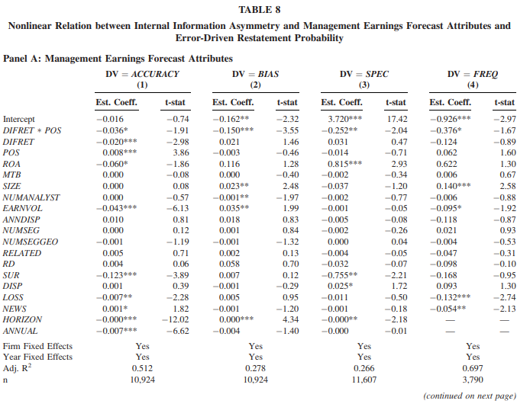
Notes:
1. High-Level Summary of Table 8
Table 8 explores whether the relationship between internal information asymmetry (IIA) and external communication quality is nonlinear, specifically focusing on situations where divisional managers have a relative information advantage over top managers. The table is divided into two panels:
●
Panel A: Examines the impact of IIA on the four attributes of management earnings forecasts previously analyzed: accuracy (ACCURACY), bias (BIAS), specificity (SPEC), and frequency (FREQ).
●
Panel B: Investigates the association between IIA and the probability of error-driven accounting restatements (RES_ERR).
The key feature of this table is the inclusion of an interaction term, DIFRET*POS, which captures the effect of DIFRET specifically when it is positive, indicating a situation where divisional managers are relatively more informed.
2. Reason for Inclusion of Table 8
This table is included to address a limitation of the primary IIA measure, DIFRET. As highlighted in the 'Advantages and Limitations of DIFRET' section1, DIFRET may not be as informative when top and divisional managers trade on entirely independent information. The authors recognize that if divisional managers possess private information that top managers don't have access to, it can create a distinct situation with potentially different implications for communication quality. By focusing on cases with positive DIFRET, the authors seek to isolate and examine the impact of divisional managers' unique private information.
3. Independent and Dependent Variables
●
Dependent Variables:
○
Panel A: ACCURACY, BIAS, SPEC, and FREQ.
○
Panel B: RES_ERR.
●
Independent Variables:
○
DIFRET: The measure of IIA.
○
POS: A dummy variable equal to 1 if DIFRET is positive, and 0 otherwise.
○
DIFRET*POS: The interaction term capturing the effect of positive DIFRET.
●
Control Variables: Both panels include the same set of control variables used in prior tables to account for other firm characteristics that could affect external communication quality.
4. Key Numbers to Pay Attention To
●
Panel A: Across all four columns, the coefficient on the interaction term DIFRET*POS is negative and statistically significant. This suggests that when divisional managers have an information advantage (positive DIFRET), the negative association between IIA and the quality of management forecasts becomes even more pronounced.
●
Panel B: The coefficient on DIFRET*POS is positive and statistically significant (1.491), indicating that a positive DIFRET is associated with a higher likelihood of error-driven restatements. This finding further supports the notion that divisional managers' superior private information can lead to challenges in preparing accurate financial statements.
●
The coefficient on DIFRET (without the interaction) is generally insignificant across both panels, except for a negative and significant association with ACCURACY in Panel A. This suggests that the overall impact of DIFRET on communication quality is largely driven by situations where DIFRET is positive.
5. Script to Explain Table 8
"Table 8 takes our analysis a step further by considering situations where divisional managers have a distinct information advantage over those at the corporate headquarters. This means that they possess crucial private information that their superiors may not fully grasp."
"What we see in Table 8 is quite intriguing. When divisional managers hold better information, the negative consequences of internal information asymmetry on communication quality are amplified. Specifically, management forecasts become less accurate, less informative, and less frequent. Moreover, we observe an increased risk of accounting errors that require subsequent restatements. This underscores the importance of recognizing and addressing information disparities within organizations, particularly when valuable insights reside at lower levels of the corporate hierarchy."

Slide 28
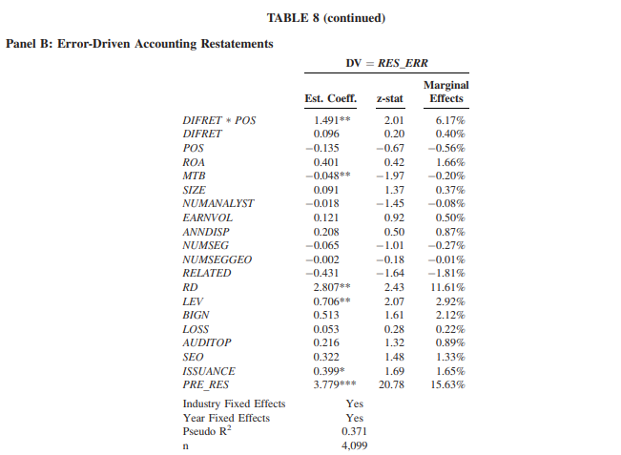
Notes:
●
Panel B: Investigates the association between IIA and the probability of error-driven accounting restatements (RES_ERR).
The key feature of this table is the inclusion of an interaction term, DIFRET*POS, which captures the effect of DIFRET specifically when it is positive, indicating a situation where divisional managers are relatively more informed.
●
Panel B: The coefficient on DIFRET*POS is positive and statistically significant (1.491), indicating that a positive DIFRET is associated with a higher likelihood of error-driven restatements. This finding further supports the notion that divisional managers' superior private information can lead to challenges in preparing accurate financial statements.
●
The coefficient on DIFRET (without the interaction) is generally insignificant across both panels, except for a negative and significant association with ACCURACY in Panel A. This suggests that the overall impact of DIFRET on communication quality is largely driven by situations where DIFRET is positive.

Slide 29
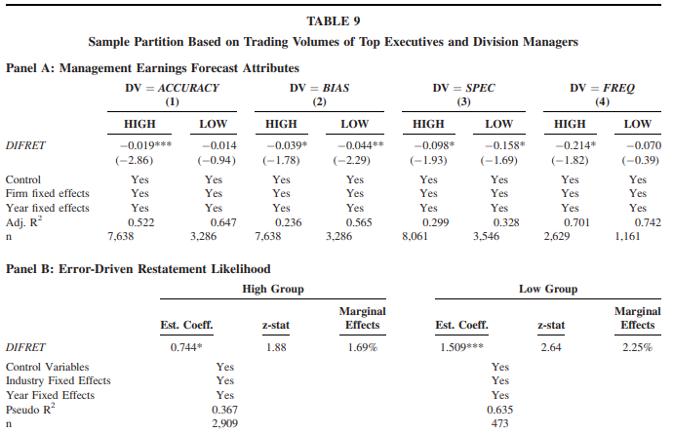
Notes:
1. High-Level Summary of Table 9
Table 9 examines the relationship between internal information asymmetry (IIA) and external communication quality by considering the trading patterns of top executives and divisional managers. The sample is split into two groups:
●
HIGH: Represents firm-years where the average dollar trading volume of top managers is higher than that of divisional managers.
●
LOW: Represents firm-years where the average dollar trading volume of top managers is lower than that of divisional managers.
The table investigates the impact of DIFRET (the measure of IIA) on four attributes of management earnings forecasts (Panel A) and the likelihood of error-driven accounting restatements (Panel B) within each of these groups.
2. Reason for Inclusion of Table 9
The authors include Table 9 to address a potential alternative explanation for the negative association between IIA and external communication quality: the possibility that top managers face greater constraints on insider trading compared to divisional managers. If top managers are more restricted in their ability to trade on private information, it could lead to a mechanically lower DIFRET, even if they possess valuable information. This could confound the interpretation of the primary findings.
By analyzing the relationship between DIFRET and disclosure quality separately for firms where top managers trade more heavily than divisional managers, the authors aim to demonstrate that the results are not solely driven by differential insider trading constraints.1
3. Independent and Dependent Variables
●
Dependent Variables:
○
Panel A: ACCURACY, BIAS, SPEC, and FREQ (four attributes of management earnings forecasts).
○
Panel B: RES_ERR (likelihood of error-driven accounting restatements).
●
Independent Variable: DIFRET.
●
Control Variables: The regressions include the same set of control variables used in prior tables to account for other firm characteristics that could affect external communication quality.2
4. Key Numbers to Pay Attention To
●
Panel A: The coefficient on DIFRET is negative and statistically significant for ACCURACY (-0.019), BIAS (-0.039), and SPEC (-0.098) in the HIGH group. This suggests that even when top managers trade more actively than divisional managers, higher IIA is still associated with less accurate, more negatively biased, and less specific management forecasts.3 This finding weakens the alternative explanation based on insider trading constraints.1
●
Panel B: The coefficient on DIFRET is positive and statistically significant (0.866) in the HIGH group for RES_ERR. This indicates that when top managers trade more than divisional managers, higher IIA is still associated with an increased probability of error-driven restatements.2 Again, this result challenges the notion that the main findings are driven solely by trading constraints on top managers.1
5. Script to Explain Table 9
"One might argue that our findings could be influenced by the fact that top managers might face more scrutiny and restrictions when it comes to trading on their private information. This could artificially make them appear less informed compared to divisional managers."
"To address this concern, Table 9 separates companies where top managers actually trade more heavily than their divisional counterparts. Even in these cases, we see that higher information asymmetry continues to be associated with poorer quality disclosures. Specifically, management forecasts tend to be less accurate and informative, and there's a greater chance of accounting errors requiring subsequent restatements. This strongly suggests that our initial findings are not simply a by-product of limitations on how top managers can trade on their information."

Slide 30
Conclusion
The authors introduce a novel measure of internal information asymmetry (IIA) within firms, termed DIFRET. DIFRET is calculated as the difference in profitability between opportunistic insider trades made by divisional managers and those made by top managers. Higher values of DIFRET indicate that divisional managers possess a greater information advantage over top managers regarding the firm's prospects.
The study reveals a significant negative relationship between IIA and the quality of external communication. When DIFRET is higher, the accuracy, specificity, and frequency of management earnings forecasts decline, and forecasts exhibit greater negative bias.
Higher IIA is also linked to an increased likelihood of error-driven restatements in financial reports. The findings suggest that when divisional managers possess superior private information, it can contribute to inaccuracies and misjudgments in the preparation of financial statements, ultimately leading to a greater need for restatements.

